Slide 1
Real-Time Distributed Algorithms
David Kozhaya
ABB Corporate Research Switzerland
Notes:
Hi everyone!
My name is David Kozhaya and I work at ABB Corporate Research in Switzerland.
You learned in Rachid’s class about distributed computing and you even designed few algorithms together for some distributed problems that rachid mentioned in the class. In today’s presentation I would like to you a glimpse of the distributed problems and challenges we face outside the boundary of this classroom.
First let me tell a bit about ABB and what ABB does!

Slide 2
Distributed Systems
Why do we need them?
Examples of Applications
Gains
Better Performance
More Storage
Higher Resilience
e-commerce
Pains
Social media
Your problem is no longer your problem alone
Blockchains
Notes:
Distributed systems comprise multiple software and hardware components that are bound to eventually fail. Such failures can cause service malfunction or unavailability, incurring signiﬁcant costs to mission-critical systems, e.g., automation systems and on-line transactions. The failures’ impact can be minimized by protocols that let systems agree on actions despite failures.
As a consequence, many variants of the agreement or the consensus problem under diﬀerent assumptions have been studied mainly .

Slide 3
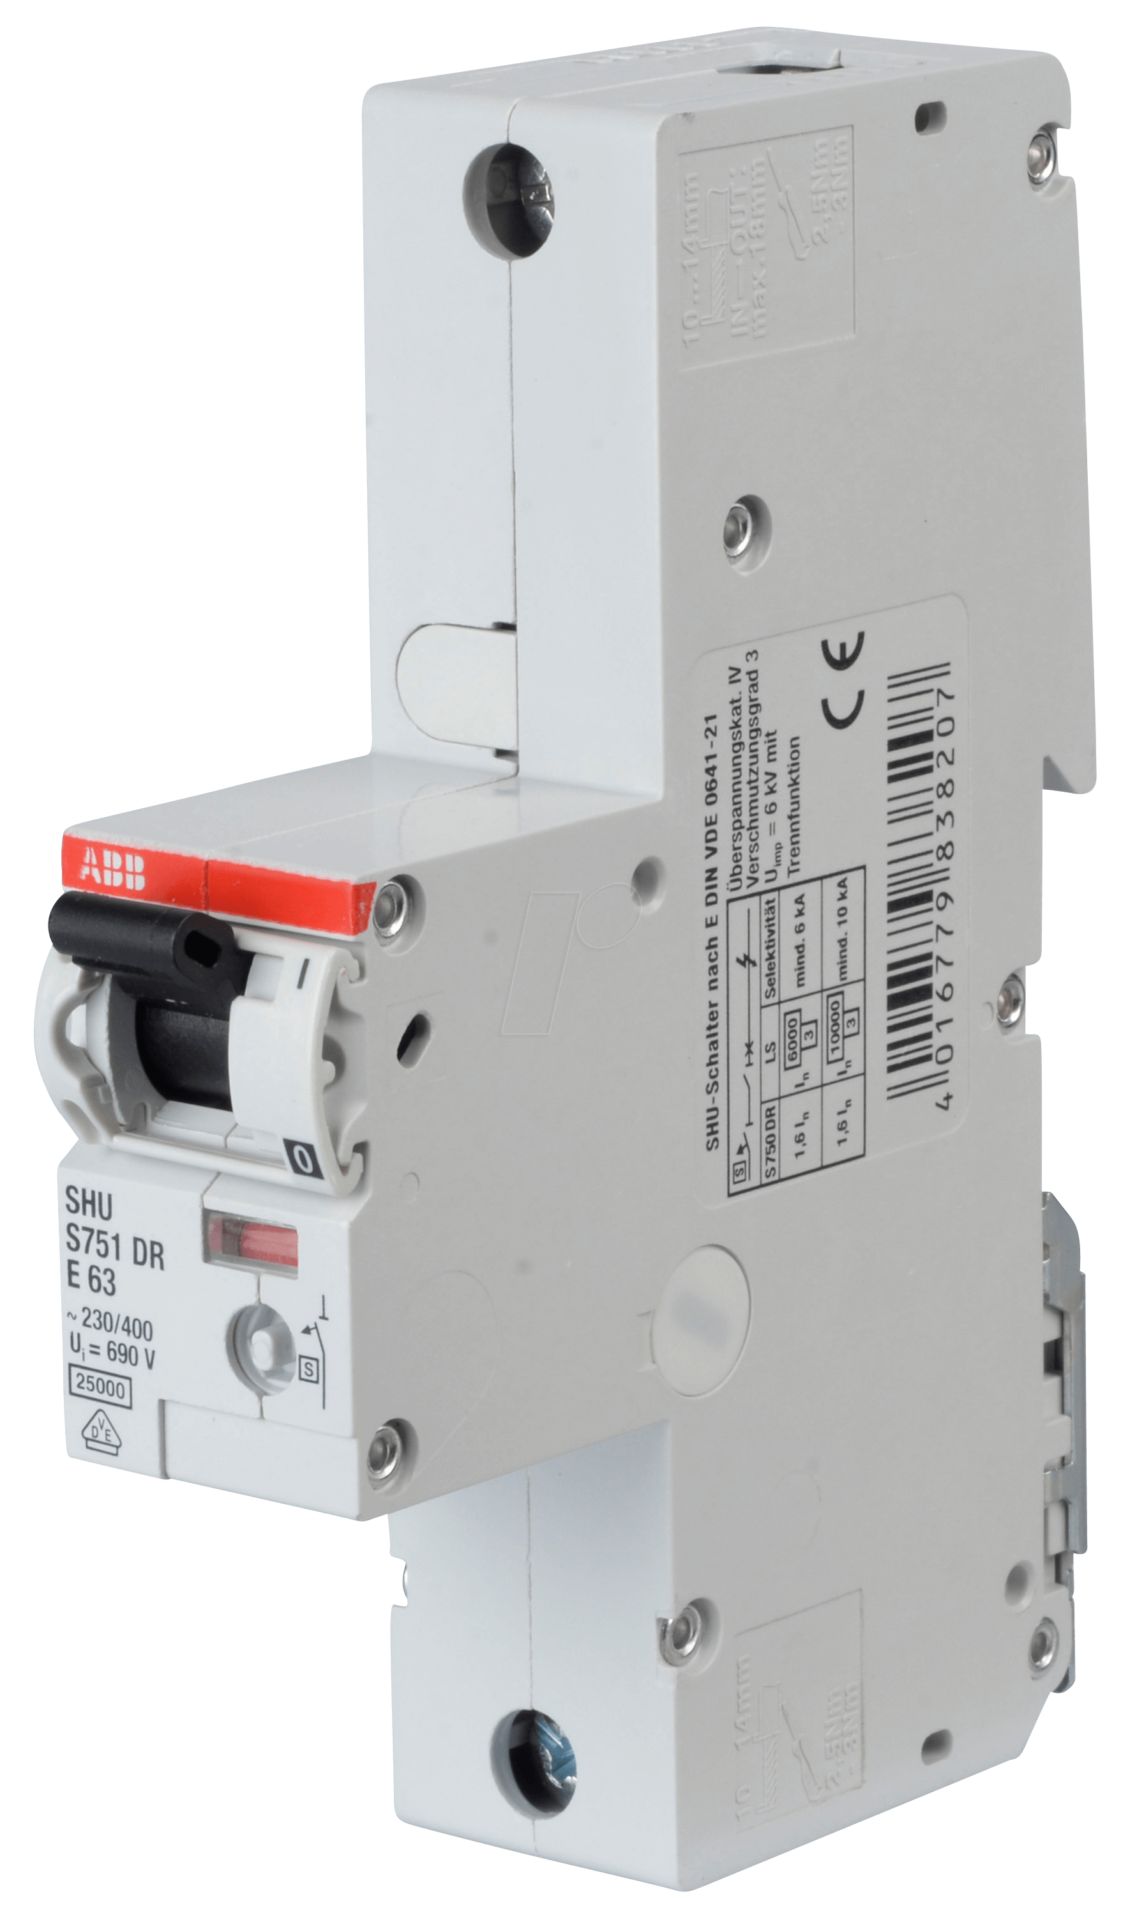
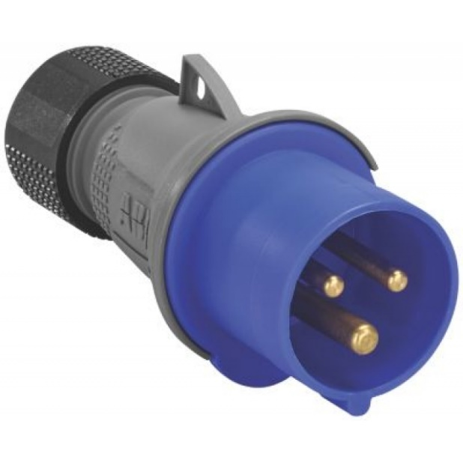
Some ABB Products
These are only a tiny part of our product portfolio
Notes:
Probably of the most things that you might affiliate us with is these power sockets which we are very well known for. What’s interesting about them is that they come in different shapes and for multiple purposes. And despite they distributed almost all around the world. They don’t really qualify as a distributed system ☺
This is why we have circuit breakers. Ok I am joking! In fact these are very tiny part of the ABB offers. While we are known and very good in designing these products this is not what kept us going for the past 25 years.
Companies like ABB that first began with production of physical components had to change in how they operate the world using physical components by

Slide 4
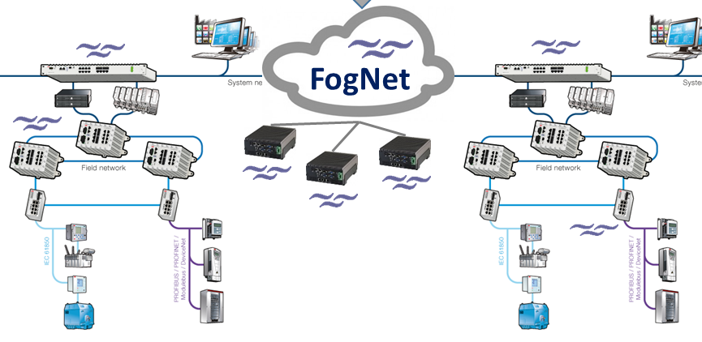
Importance of Distributed Systems to ABB
Distributed Systems Projects at ABB
Distributed Control Systems
Auxiliary Control Applications
ABB Cloud Platform & Analytics
Operator stations
Fog
servers
controllers
Field devices
Smart Cities
Collaborative Robots
ABB Service Smart Contracts
Notes:
DCS:
A distributed system for example monitors temperature and pressure of within a tank.
If some controller fails some other controller needs to jump in and take the tasks of the new one
all components should have a consistent view (consensus) about what controllers are up and what tasks they are executing.
Fog computing
Commission an industrial site, we typically over provision, meaning that we use more resources that we actually need just to be on the safe side.
One question is how we can make use of the spare resources in the system to run monitoring applications and auxiliary application on the fly and in between industrial sites.
Ability
Sensors communicate data relative to the what they see.
Huge data is generated and needs to be analyzed.
Communication
Smart cities
Many process like buildings, cars, weather, human actions, electric gird that needs to be monitored.
Way of communicating data to efficiently, reliably and within certain timing constraints. Broadcast protocols
Collaborative robots:
While robots are made smarter helping humans they remain doing decision on singular basis. This limits what robots can achieve and how big they can actually view their environment.
Collaborative robots aim at having robots talk to each other and jointly decide based on the combined input.
Example about self driving cars.
Smart contract:
ABB not only produces physical components but also actually offers services to customers.
For example, we offer in many case to maintain certain electrical installations
For that we have a maintenance agreement with the customer, which is still governed by paper contracts.
Consider and internet provider,
I hope that by now I have shown you and convinced you that indeed many distributed problems are very important and relevant to ABB’s projects and vision. So the question that could be of internest to you now is the following.
How similar are the contexts we study in class to those that I have showed you here,
In other words, can we directly use the algorithms you deviced here in class?

Slide 5
Distributed Systems
Industrial vs. Traditional
How are they different?

Slide 6
Traditional Distributed Systems
Solution approach
Distributed Abstractions
Abstraction
1
Define problem as an abstraction
2
3
Safety Properties
Distributed Problem
Liveness Properties
No duplication
No creation
Agreement
Reliable Broadcast
Validity

Slide 7
Traditional Distributed Systems
The modular solution approach
Distributed Abstractions
No duplication
No creation
Agreement
1
Define problem as an abstraction
2
Implement abstraction in a system model
3
Validity
Reliable Broadcast Abstraction (RB)
Algorithms to implement RB in
Synchronous
Partially Sync
Asynchronous

Slide 8
Traditional Distributed Systems
Solution approach
Distributed Abstractions
1
Define problem as an abstraction
2
Implement abstraction in a system model
3
Use abstraction as building block
Algorithms to implement consensus
Reliable Broadcast
Reliable Broadcast
Reliable Broadcast
Synchronous
Partially Sync
Asynchronous
Never changing and/or never ending conditions

Slide 9
Cyber-physical Systems
Differences with Traditional Distributed Systems
Smart City: An Example of a Cyber-physical System
Differences in Abstractions
Energy Efficiency
Battery operated devices
Real-time behavior
Hard timing deadlines

Slide 10
Cyber-physical Systems
Differences with Traditional Distributed Systems
Smart City: An Example of a Cyber-physical System
Difference in System Models
fiber
Time varying quality of communication links
Links oscillate between synchrony and asynchrony phases
powerline
wireless

Slide 11
Distributed Systems
Industrial vs. Traditional
Walking Through an Example

Slide 12
Asynchronous Model
Processes:
Synchronous
Some can fail
Communication links:
A link is reliable but asynchronous
No guarantee when message get delivered

Slide 13
Broadcast Protocols
No duplication: No message is delivered more than once
No creation: If a process delivers message m with sender s, then s broadcast m
Agreement: if a correct process delivers m, then every correct process delivers m
Asynchronous System
with f<n
in
Validity: If a correct broadcasts m, then every correct process eventually delivers m
Reliable Broadcast Abstraction (RB)

Slide 14
Reliable Broadcast (RB)
Algorithm for Partially Synchronous System
@ process p
delivered={}
Upon event broadcast(m)
∀s ∈ ∏ :
send(p, m) to s;
Upon event deliver(q, m)
if (m ∉ delivered){
RB-deliver(m);
delivered=delivered U {m};
if(q!=p){
∀s ∈ ∏ :
send(p, m) to s;
}
}
RB-broadcast (m)
RB-deliver (m)
p
RB-deliver (m)
q
RB-deliver (m)
r
RB-deliver (m)
s
Notes:
Send broadcast and when deliverd when broadcast message is received

Slide 15
New System Model
Probabilistically Synchronous
Processes:
Synchronous
Some can fail
Communication links:
During any transmission, a link is reliable and synchronous (timely) with probability p

Slide 16
Broadcast Protocols
No duplication: No message is delivered more than once
No creation: If a process delivers message m with sender s, then s broadcast m
Agreement: If a correct process delivers m, then every correct process delivers m
Timeliness: If a correct process broadcasts m at time t, then any correct process that delivers m does so by t+ Δr
Probabilistically Synchronous System
in
+
P
Validity: If a correct broadcasts m, then every correct process eventually delivers m
Real-time Reliable Broadcast Abstraction (RTRB)

Slide 17
Real-time Reliable Broadcast (RTRB)
Algorithm for Probabilistically Synchronous System with P
p
q
Impossible
r
s
Notes:
Send broadcast and when deliverd when broadcast message is received

Slide 18
Real-time Reliable Broadcast (RTRB)
Algorithm for Probabilistically Synchronous System with P
For any predefined Δr
Timing Failures
p
q
r
s
Notes:
Send broadcast and when delivered when broadcast message is received

Slide 19
Transforming Timing Failures into Process Failures
For any predefined Δr
p
Detect Timing Failures
Force affected process to crash
q
r
s
Notes:
Send broadcast and when deliverd when broadcast message is received

Slide 20
Failure Detector TP
+
P
Every process suffering more than “x” consecutive timing failures eventually crashes

Slide 21
Broadcast Protocols
No duplication: No message is delivered more than once
No creation: If a process delivers message m with sender s, then s broadcast m
Agreement: If a correct process delivers m, then every correct process delivers m
Timeliness: If a correct process broadcasts m at time t, then any correct process that delivers m does so by t+ Δr
Probabilistically Synchronous System
in
+
TP
Validity: If a correct broadcasts m, then every correct process eventually delivers m
Real-time Reliable Broadcast Abstraction (RTRB)

Slide 22
Real-time Reliable Broadcast (RTRB)
Algorithm for Probabilistically Synchronous System with TP
@ process p
delivered={}; acks={}; correct = ∏;
Upon event broadcast(m)
while (acks!=correct){
∀s ∈ correct :
send(p, m) to s;
}
Upon event deliver(q, m) from sender a
acks=acks U {a}
if (m ∉ delivered){
RB-deliver(m);
delivered=delivered U {m};
while(acks!=correct){
if(q!=p){
∀s ∈ ∏ :
send(p, m) to s;
}
}
}
upon event crash(q)
correct = correct - {q};
RB-broadcast (m)
RB-deliver (m)
p
RB-deliver (m)
q
RB-deliver (m)
r
RB-deliver (m)
s
Notes:
Send broadcast and when deliverd when broadcast message is received

Slide 23
Process Faults Vs Timing Faults
How are they different?
Process failures are system-wide
Timing failures are algorithm dependent
Notes:
Why not just assume late processes as failed ones in the system model?
True we can but the problem is that in practice how can we make such processes aware that they have been late and that are faulty. Important for time critical applications running on top.

Slide 24
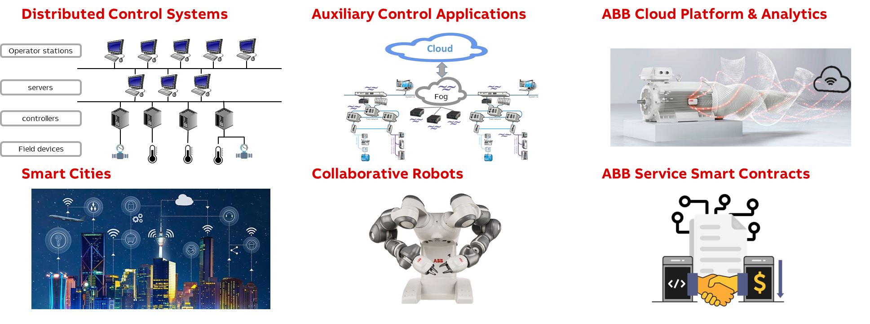
Many Challenges and Opportunities in Industrial Distributed Systems
For Internships or Master Thesis at ABB send to david.kozhaya@ch.abb.com
Resume
Motivation letter
Transcripts
Notes:
Yippie, already at the end ☺
You’ve seen how we can describe distributed systems with lossy communication as well as permanent and transient failures
We devise a wrapper to use CS algorithms unchanged in real systems and for what class of algorithms the wrapper works.

